Slide 1
NAFEMS Technical Working Group Overview
Manufacturing Process Simulation (MANWG)
2023

Slide 2
Manufacturing Process Simulation (MANWG)
The NAFEMS Manufacturing Process Simulation Working Group (MANWG) was launched in February 2016 with the following mission statement:
‘to promote the development and use of virtual manufacturing tools within the product design and
manufacturing cycle to improve outcomes in industrial manufacturing processes’.
The Manufacturing Process Simulation Working Group has three Focus Groups, concentrating on Composites, Metallic Additive Manufacturing and Metals.
Monthly online meetings via WebEx
Chair – Sjoerd VAN DER VEEN, Airbus
Vice Chair – Anas Yaghi, Manufacturing Technology Centre
MANWG Composites Focus Group Chair –
MANWG Metallic Additive Manufacturing Focus Group Chair –
MANWG Metals Focus Group Chair – Trevor Dutton, Dutton Simulation
The group includes representatives of The Aerospace Corporation, Airbus, ANSYS, Boeing, Brunel University, Convergent, Dutton Simulation, Enginsoft, ESI, Grundfos, Manufacturing Technology Centre, National Composites Centre, Rolls Royce, SAFRAN, Southwest Research Institute, SWRIM, Tecnalia, Tesla, Transvalor S.A., TWI Ltd, Universitat Politecnica de Catalunya - CIMNE, University of Strathclyde/AFRC, Warwick University / WMG, Wilde Analysis
Information about the Manufacturing Process Simulation Working Group can be found on the NAFEMS website at www.nafems.org/community/working-groups/manufacturing-process-simulation
To enquire about joining this working group complete the online form at www.nafems.org/community/working-groups/manufacturing-process-simulation/get_involved

Slide 3
Manufacturing Process Simulation (MANWG)
The MANWG aims to be a focal point for independent and reliable information on simulation capabilities and requirements, specifically by pursuing its goals of:
Increasing awareness of virtual manufacturing and its value in real-world manufacturing
Making virtual manufacturing tools wide-spread and effective in design and execution of manufacturing processes
Making virtual manufacturing tools more accurate, by proposing benchmarks
Sharing best practice (how-to guides) and promote the standardisation of modelling approaches and corresponding material characterisation tests
Making the use of virtual manufacturing tools more efficient
Becoming a hub for modellers to be well informed and interconnected concerning simulation matters
Facilitating innovation through the promotion and support of virtual manufacturing tools within academia, policy makers and throughout the manufacturing community

Slide 4
Manufacturing Process Simulation (MANWG)
MANWG Composites Focus Group:
The MANWG Composites Focus Group was set up in 2018 and aims to:
  Make virtual manufacturing tools wide-spread and effective in design and execution of manufacturing processes
  Share best practice (how-to guides) and promote the standardisation of modelling approaches and corresponding material characterisation tests
Further details of the group’s aims and activities can be found at https://www.nafems.org/community/working-groups/manufacturing-process-simulation/composites_manwg_focus_group/.

Slide 5
Manufacturing Process Simulation (MANWG)
MANWG Metallic Additive Manufacturing Focus Group:
The MANWG Metallic Additive Manufacturing Focus Group was set up in early 2017 and aims to:
  Share best practice (how-to guides) and promote the standardisation of modelling approaches
  Make virtual manufacturing tools more accurate, by proposing benchmarks
  Make the use of virtual manufacturing tools more efficient
Further details of the group’s aims and activities can be found at https://www.nafems.org/community/working-groups/manufacturing-process-simulation/metallic_additive_manufacturing_focus_group/.

Slide 6
Manufacturing Process Simulation (MANWG)
MANWG Metals Focus Group:
The MANWG Metals Focus Group was set up in early 2018 and aims to:
  Promote best practice simulation methods for all manner of metal forming and joining processes, by:
    describing methods of carrying out metal forming and joining process simulation, including standardised modelling practices
    demonstrating the benefits from adopting simulation
    providing a source of information on how to carry out simulation successfully.
  Identify the aspects of simulation that require more investigation to allow more widespread and effective use of these methods in industry, including:
    determining the most challenging technical issues in metal forming and joining process simulation for further research
    proposing benchmarks to improve the efficiency and accuracy of simulation software
Further details of the group’s aims and activities can be found at https://www.nafems.org/community/working-groups/manufacturing-process-simulation/metals_manwg_focus_group/.

Slide 7
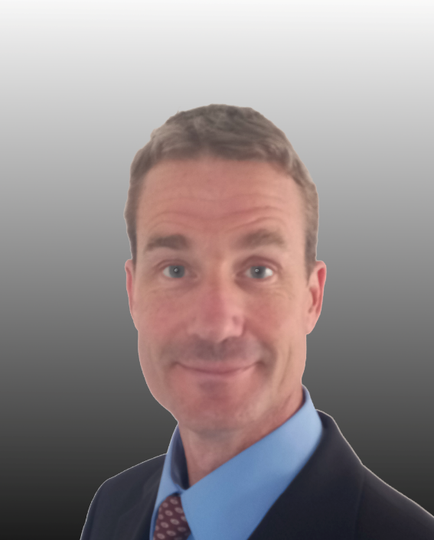
Chair Bio
Sjoerd VAN DER VEEN:
Sjoerd has been working for Airbus in the Engineering department since 2006. He is at the origin of a newly created team, fully dedicated to the modelling of materials and physics-based simulation of manufacturing processes. He currently holds the title of Senior Expert in this field and is dedicated to the development of new technical capabilities and standardisation and democratisation of mature methods. Before joining Airbus, Sjoerd
Has worked for 10 years in the European steel- and aluminium industry.
He has experience with modelling transformations in- and the behaviour of- light alloys and carbon-epoxy composites. He has simulated metal forming (hot, cold, fast, slow), metal additive manufacturing, polymer additive manufacturing, the curing of thermoset composites and several other manufacturing- and assembly processes used to produce primary aircraft structure.

